Slide 1
Chapter 8
Circuit Switching
and
Telephone Network

Slide 2
8.1 Circuit Switching
Space-Division Switch
Time-Division Switch
TDM Bus
Combinations

Slide 3
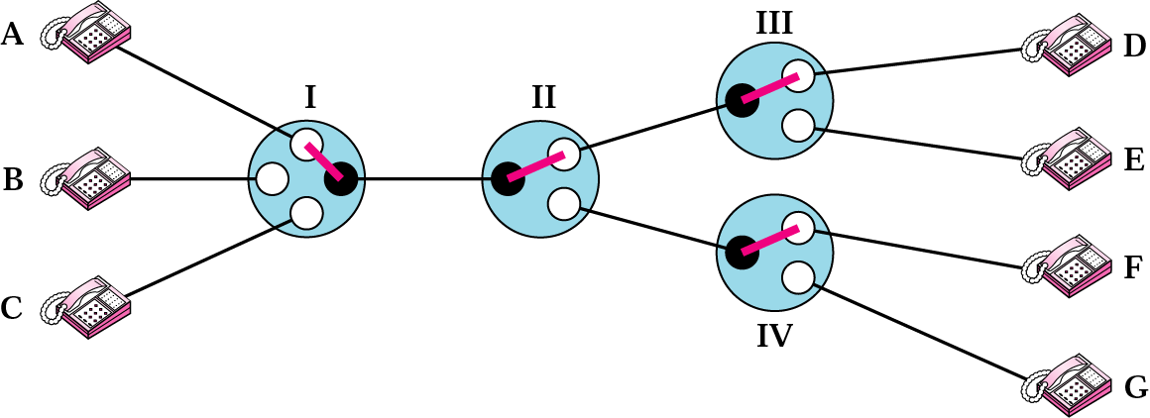
Figure 8.1 Circuit-switched network

Slide 4
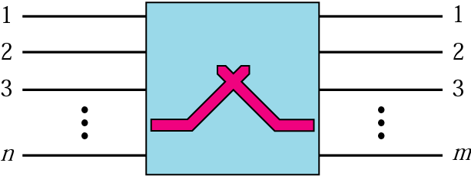
Figure 8.2 A circuit switch

Slide 5
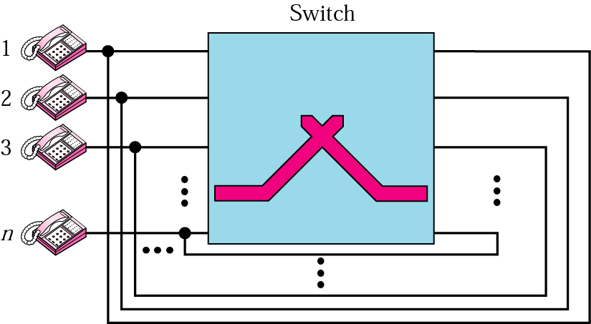
Figure 8.3 A folded switch

Slide 6
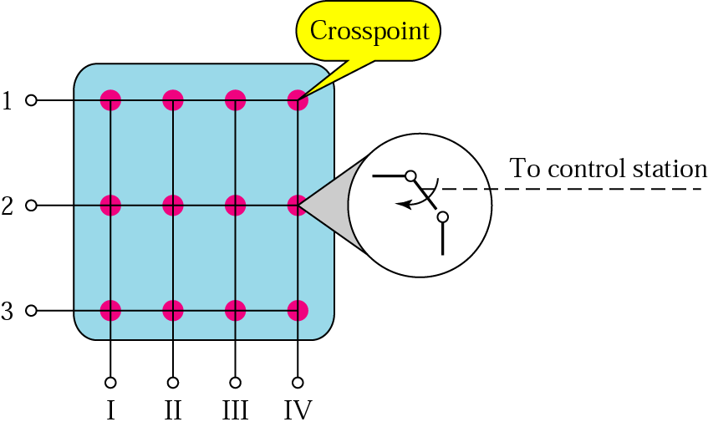
Figure 8.4 Crossbar switch

Slide 7
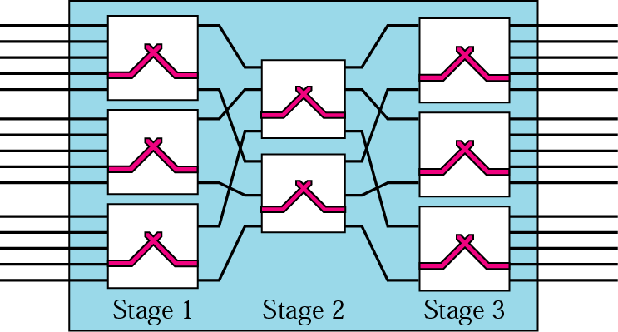
Figure 8.5 Multistage switch

Slide 8
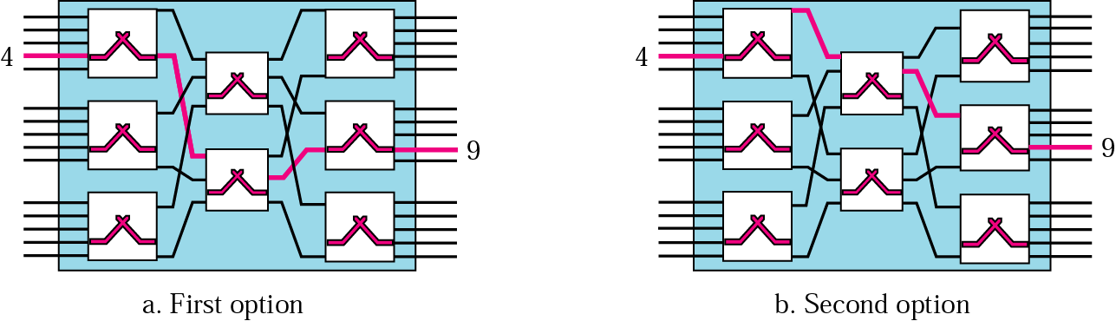
Figure 8.6 Switching path

Slide 9
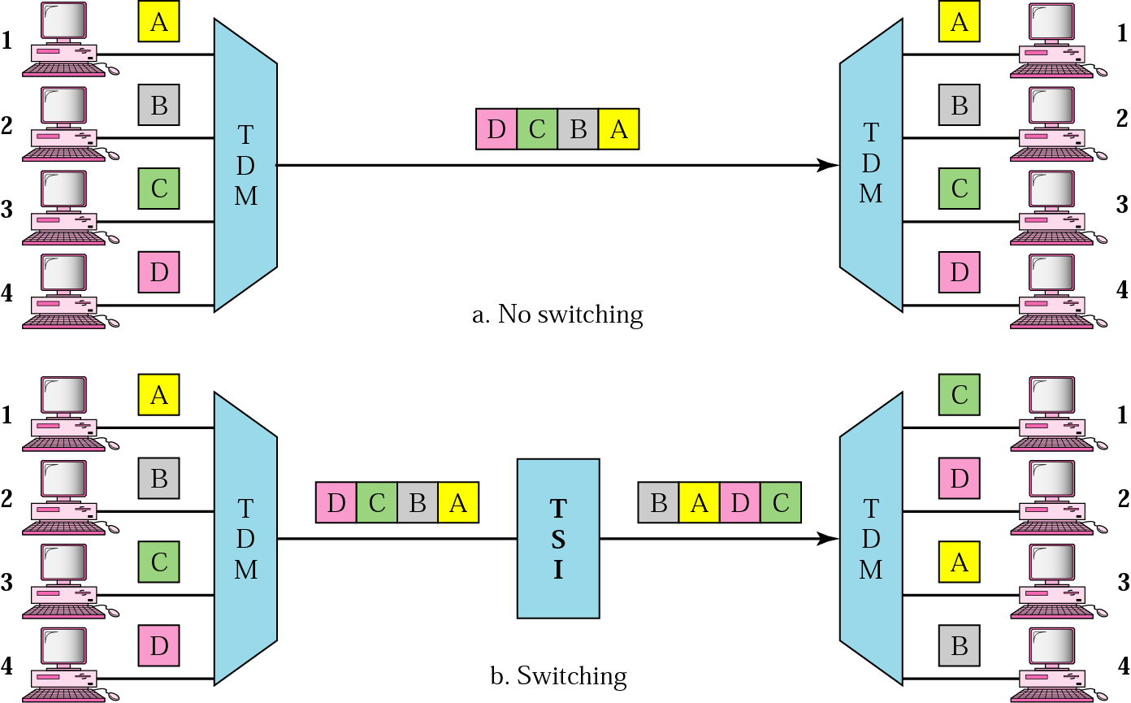
Figure 8.7 Time-division multiplexing, without and with a time-slot interchange

Slide 10
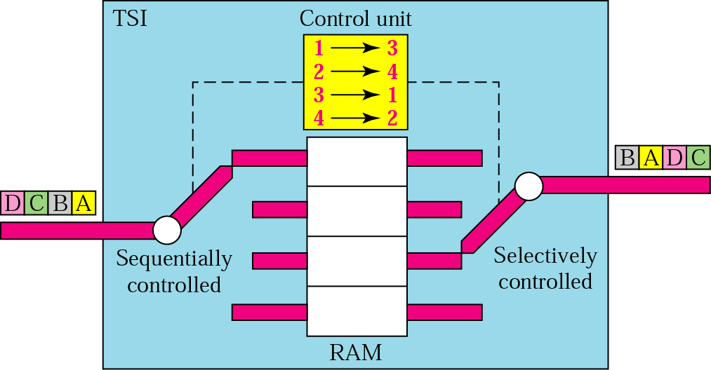
Figure 8.8 Time-slot interchange

Slide 11
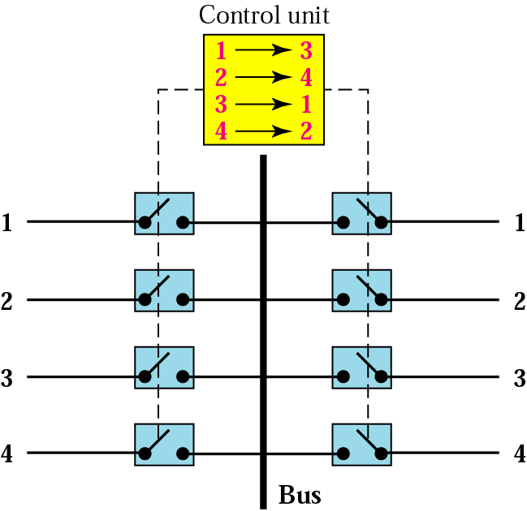
Figure 8.9 TDM bus

Slide 12
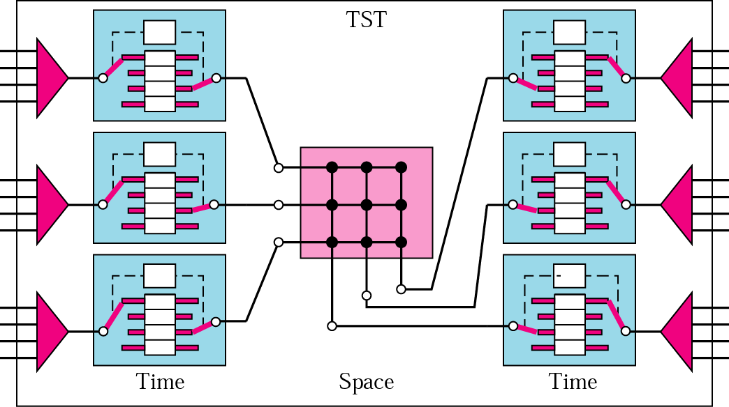
Figure 8.10 TST switch

Slide 13
8.2 Telephone Network
Major Components
LATAs
Making a Connection
Analog Services
Digital Services
A Brief History

Slide 14
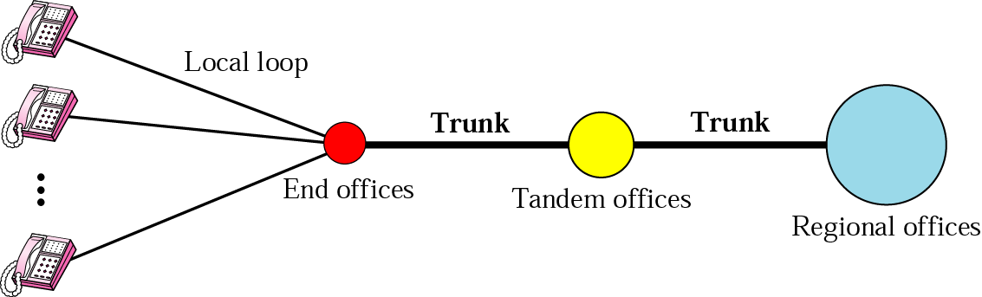
Figure 8.11 A telephone system

Slide 15

Note:
Intra-LATA services are provided by local exchange carriers. Since 1996, there are two types of LECs: incumbent local exchange carriers and competitive local exchange carriers.

Slide 16
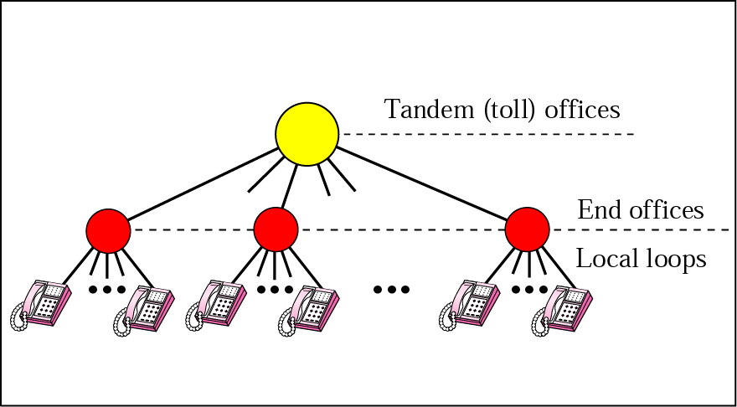
Figure 8.12 Switching offices in a LATA

Slide 17
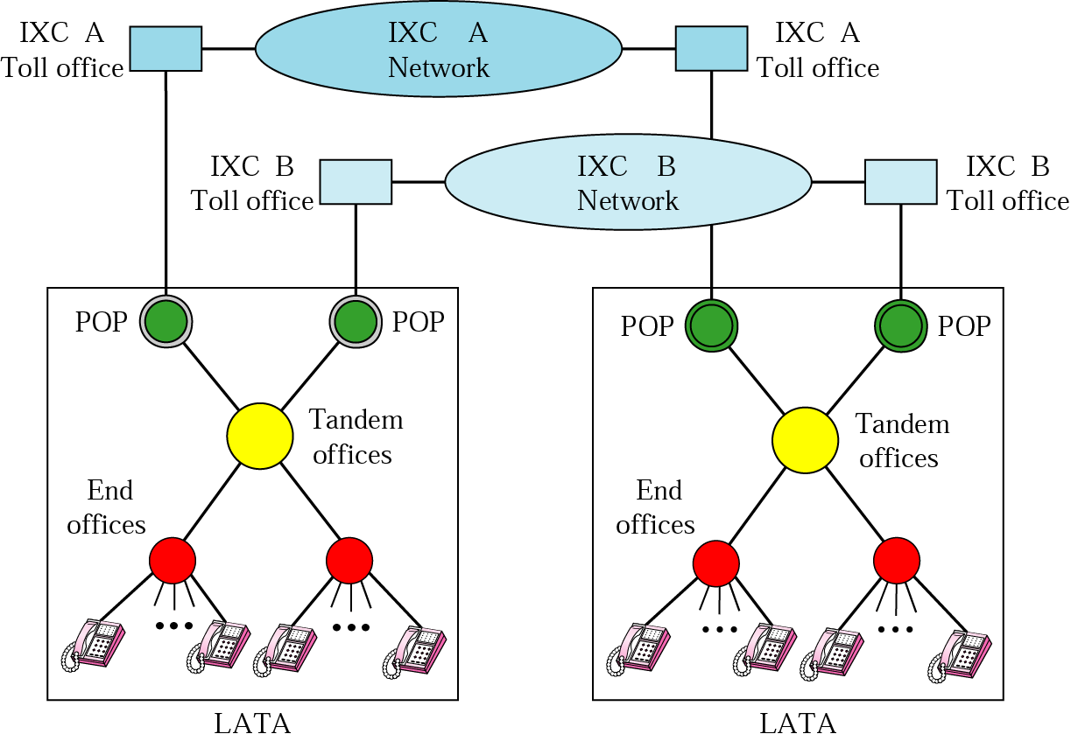
Figure 8.13 POPs

Slide 18
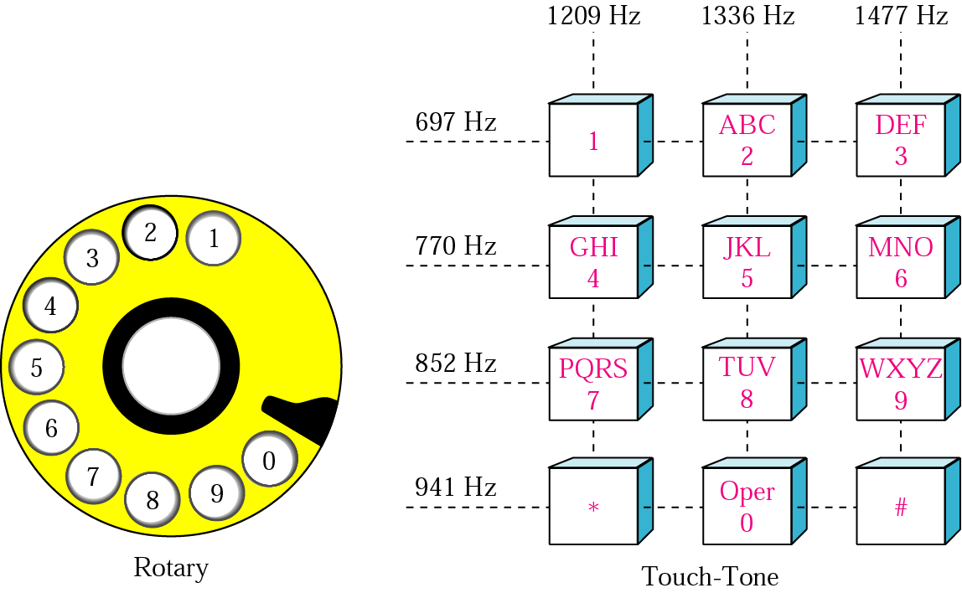
Figure 8.14 Rotary and touch-tone dialing

Slide 19
Note:
Voice communication used analog signals in the past, but is now moving to digital signals. On the other hand, dialing started with digital signals (rotary) and is now moving to analog signals (touch-tone).

